Slide 1
VANDE BHARAT EXPRESS Report
By _ Mehak Nirala

Slide 2
List of Content
Power BI Tools used
Dashboard
Summary of data analyse
Skill Learned
Acknowledgement

Slide 3
Power BI Tools Used
Table
Charts
Slicer
Hyperlink
Map
Dax function

Slide 4
Vande Bharat Express
The first Vande Bharat Express train was flagged off on February 15, 2019, on the New Delhi-Kanpur-Allahabad-Varanasi route, running at a speed of 160 kilometers per hour.
Vande Bharat Express is a medium to long-distance semi-high speed superfast express service operated by Indian Railways. It is a reserved, air-conditioned chair car service connecting cities that are less than 800 km (500 mi) apart or take less than ten hours to travel with existing services and a planned reserved, air-conditioned sleeper service connecting cities that are 800 km (500 mi) to 1,200 km (750 mi) apart. The train was a part of the 'Make in India' initiative by the government and entered commercial service on 15 February 2019.

Slide 5
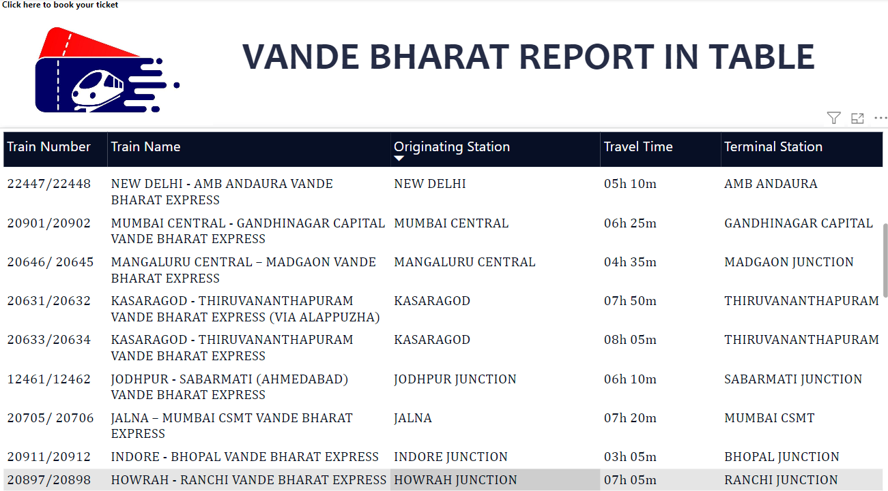
Dashboard Snippets

Slide 6
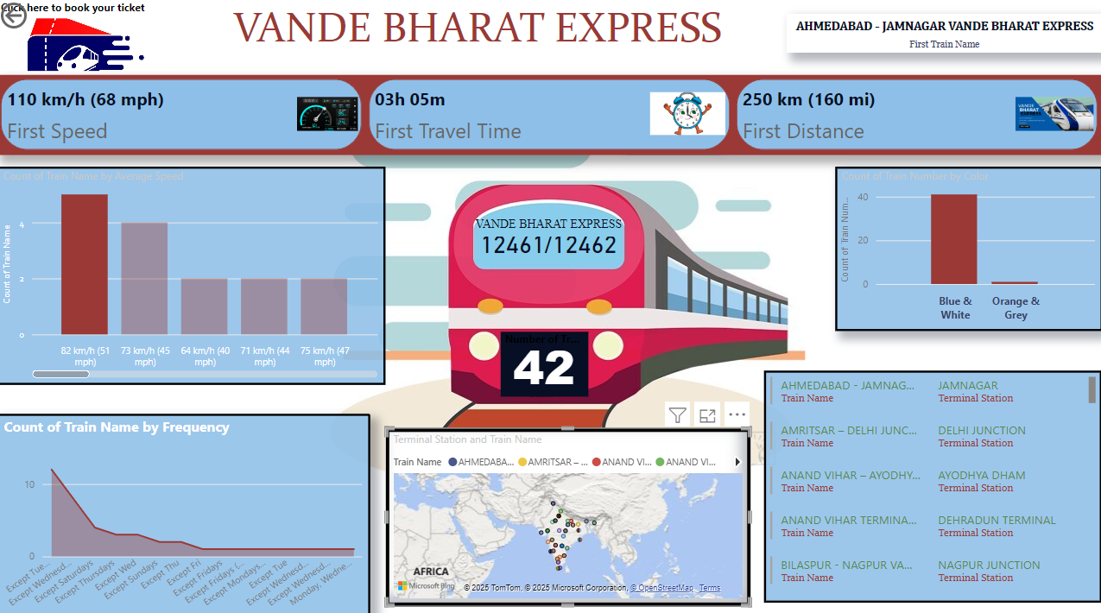

Slide 7
Skill learned
Analyzing large data set and finding out key performance indicators which you have to present on dashboard.
How to categorized data in different way like Chart, Table etc.
How to use Map in Power BI
How can Attach hyperlink in Power BI
DAX Function

Slide 8
Acknowledgement
I would like to express my special thanks of gratitude to my teacher ‘ Mr. Diwakar sir’ at DUCAT IT TRAINING school for providing us with the appropriate skills to be able to present this project theme –VANDE BHARAT EXPRESS with the utmost confidence and knowledge. It help me in increasing my power bi domain knowledge and skills in analysing data.

Slide 9
Thank You

